Slide 1
File Integrity Monitoring System
Name: Hamna Masood
RollNo: BITF24A042
Course: Informaion Security
Section: Afternoon

Slide 2
Problem Statement
-Files can be modified or deleted without detection
-Important data integrity is at risk
-Need a system to detect changes in files

Slide 3
Objectives:
-Detect file modification
-Detect file deletion
-Maintain baseline of file hashes
-Ensure file integrity

Slide 4
Tools/Concepts Used:
-C++ Programming
-File Handling (ifstream, ofstream)
-Hashing Technique (Polynomial / MD5 / SHA-256)
-Data Integrity Concept

Slide 5
System Working:
- User enters file names
- System calculates hash of each file
- Stores baseline (filename + hash)
- Later recalculates hash
- Compares old vs new hash
. OUTPUT:
- Safe
-Modified
-Deleted

Slide 6
Hashing Technique:
- Simple string hashing method
- Order-sensitive
- Used for integrity checking

Slide 7
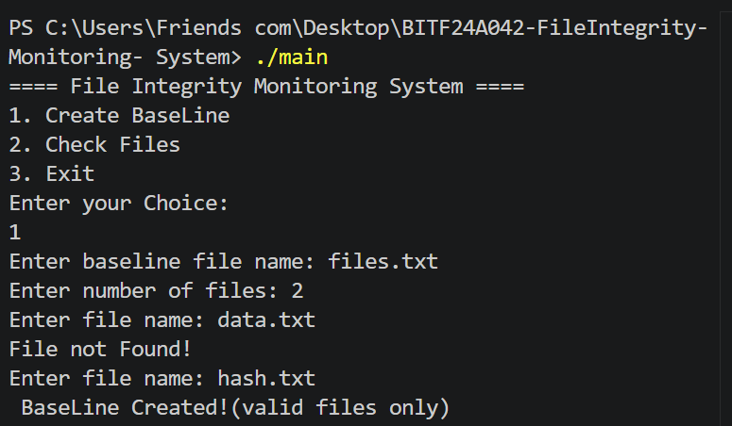
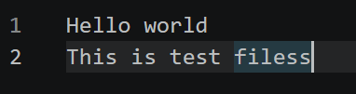
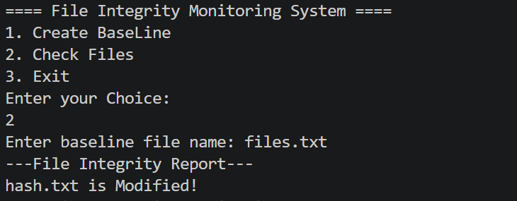
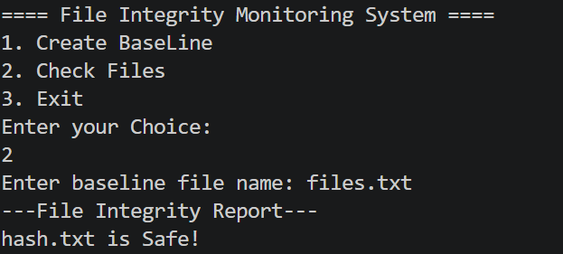
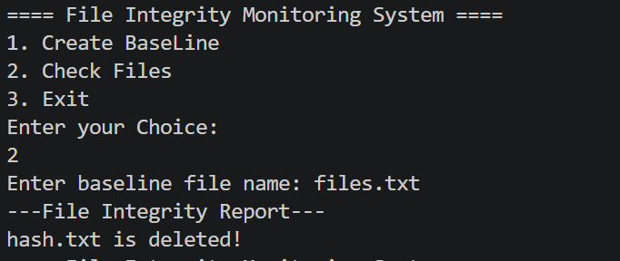
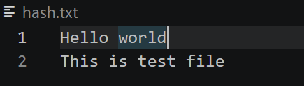
Demo/Output:
1-Creating BaseLine Filename:
3-Modified hash.txt
5-When File is Modified:
4-When File is safe:
6-When File is Deleted:
2-Original hash.txt

Slide 8
CONCLUSION
- System successfully detects file changes
- Ensures basic data integrity
- be improved using SHA-256 in future

